Slide 1
E-commerce in Your Inbox Product Recommendations at Scale
Date: 2015/12/17
Author: Mihajlo Grbovic, Vladan Radosavljevic,Nemanja Djuric, Narayan Bhamidipati, Jaikit Savla, Varun Bhagwan,Doug Sharp
Source: KDD’15
Advisor: Jia-Ling Koh
Speaker:Chen-Wei Hsu

Slide 2
Outline
Introduction
Method
Experiment
Conclusion

Slide 3
Introduction
Motivation
online advertising has become increasingly ubiquitous and effective
leverages user purchase history determined from email receipts to deliver highly personalized product ads to Yahoo Mail users

Slide 4
Introduction
Chanllage
User willing to click on ads is a challenging task
In addition to financial gains for online businesses ,proactively tailoring advertisements to the tastes of each individual consumer also leads to an improved user experience, and can help with increasing user loyalty and retention

Slide 5
Introduction
showing popular products to all users, showing popular products in various user groups (called cohorts, specied by user's gender, age, and location), as well as showing products that are historically frequently purchased after the product a user most recently bought

Slide 6
Outline
Introduction
Method
Experiment
Conclusion

Slide 7
Method
Task
leverages information about prior purchases determined from e-mail receipts
learning representation of products in low-dimensional space from historical logs using neural language models

Slide 8
Method
Low-dimensional product embeddings
Prod2vec
learning vector representations of products from e-mail receipt logs by using a notion of a purchase sequence as a "sentence" and products within the sequence as "words“
P($p_{i+j}$| $p_{i}$) of observing a neighboring product $p_{i+j}$ given the current product pi is defined using the soft-max function

Slide 9
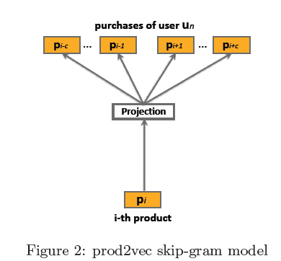
Prod2vec learns product representations using the skip-gram model by maximizing the objective function over the entire set S of e-mail receipt logs

Slide 10
Method
bagged-prod2vec
multiple products may be purchased at the same time, we
propose a modied skip-gram model that introduces a notion
of a shopping bag

Slide 11
Method

Slide 12
Method
Product-to-product predictive models
prod2vec-topK :
Given a purchased product, the method calculates cosine similarities to all other products in the vocabulary and recommends the top K most similar products
prod2vec-cluster:
considered grouping similar products into clusters and recommending products from a cluster that is related to the cluster of previously purchased product
K-means

Slide 13
Method
where $θ_{ij}$ is the probability that a purchase from cluster ci is followed by a purchase from cluster $c_{i}$
products from the top clusters are sorted by their cosine similarity to p , and we use the top K products as recommendations

Slide 14
Method
User-to-product predictive models
a novel approach to simultaneously learn vector representations of products and users such that, given a user, recommendations can be performed by finding K nearest products in the joint embedding space
User2vec

Slide 15
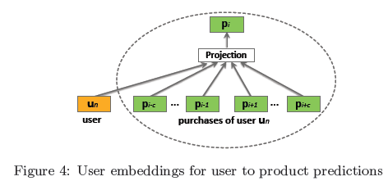
Method
User2vec
Advantages
the product recommendations are specically tailored for that user based on his purchase history
Disvantages
the model would need to be updated very frequently.
Unlike product-to-product recommendations, which may be relevant for longer time periods, user-to-product recommendations need to change often to account for the most recent user purchases

Slide 16
Outline
Introduction
Method
Experiment
Conclusion

Slide 17
Experiments
Data set
data sets included e-mail receipts sent to users who voluntarily opted-in for such studies, where we anonymized user IDs
Training data set collected for purposes of developing product
prediction models comprised of more than 280.7 million
purchases made by N = 29 million users from 172 commercial
websites

Slide 18
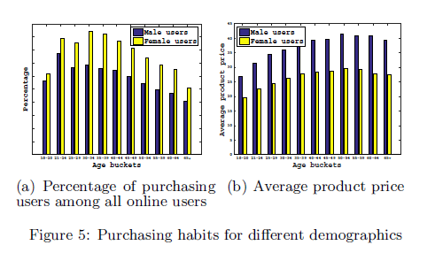
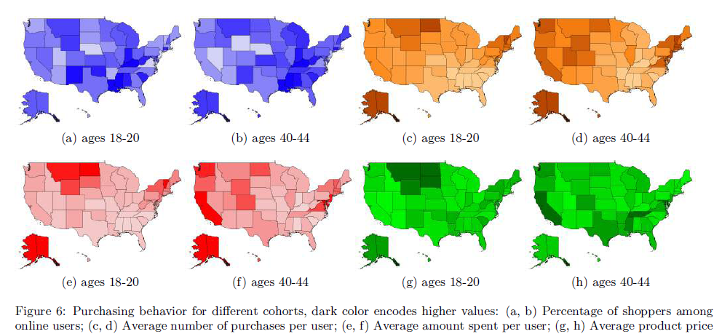
Experiments
Insights from purchase data

Slide 19
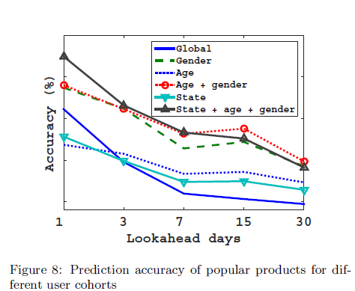
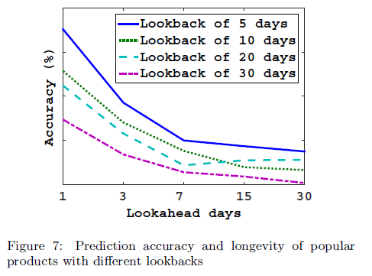
Experiments
Recommending popular products

Slide 20
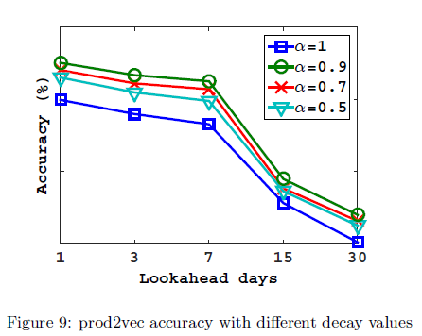
Experiments
Recommending popular products

Slide 21
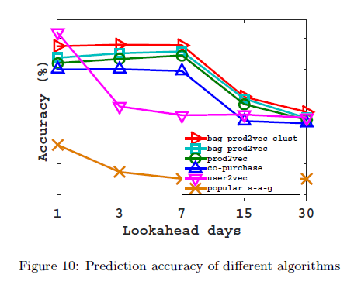
Experiments
Recommending predicted products

Slide 22
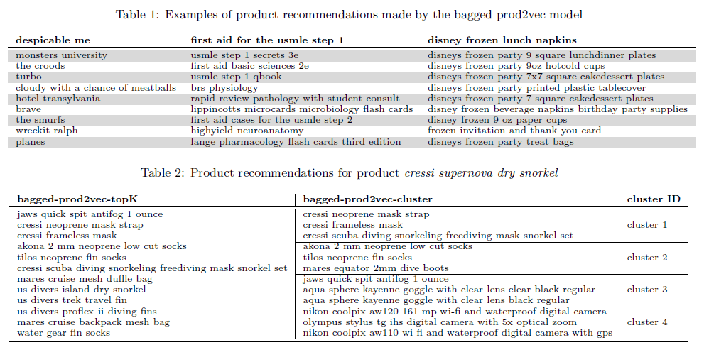
Experiments
Recommending predicted products

Slide 23
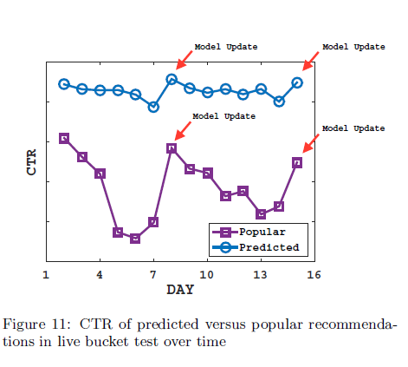
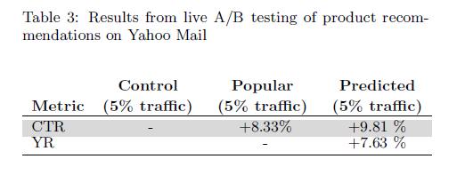
Experiments
Recommending predicted products

Slide 24
Outline
Introduction
Method
Experiment
Conclusion

Slide 25
Conclusion
In our ongoing work, we plan to utilize implicit feedback available through ad views, ad clicks, and conversions to further improve the performance of our product recommendation system

